Slide 1
Titanic Features
From Bare Min (Ronel, Shusheng, Zilu, Michelle)

Slide 2
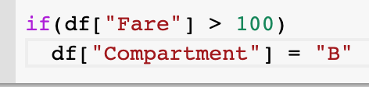
Compartment
Used the fares to put the rest of Na’s in each Compartment
Put Compartment by buckets based on fare price
Anything less than 20 for fare was F
Anything greater than 100 for fare was B
Compartment F and B had more passengers
Used Compartment_B
Code snippet:
For rest of NAs:

Slide 3
Cabin_nan
Used all the nan values, since had high correlation with survived column from the pd_get dummies

Slide 4
Females and Boys
Saw that boys were more likely to survive even though there was less
Combine the boys and female together
Took men whose ages was less than 13 for boys

Slide 5
Ticket number
Grouped ticked by each number and average to see the survived ticket in train
Set all males in column to 0 since they most likely died
Used ticket grouped survived to see if women and boys survived.
Code snippet:
If average ticket survived was 1 set row to 1, else if average was 0, .5, .75, set the row to 0.
Notes:
Grouped by ticket number of JUST female and boys

Slide 6
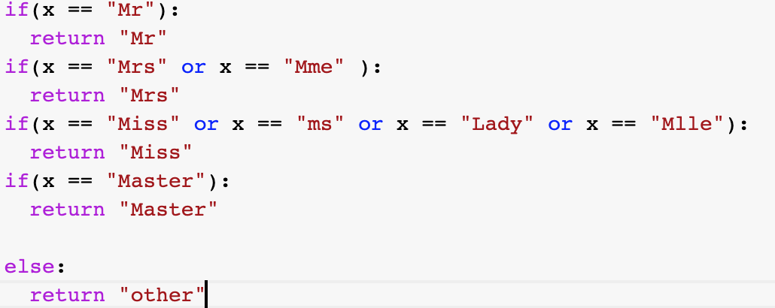
Name
Took the titles of each string
Had a Mr. title, Combined Mrs. and Mme, and Miss, ms, Lady Mlle, Master
The rest of titles were Other
Notes:
Master = young boys/ children

Slide 7
P_class
Use P_class 1 and 3, since they were most likely to survive.
Converted P_class to string for one hot encoding

Slide 8
Family Size
Added Sibsp and Parch columns together.

Slide 9
pClass*Fare
Times P_class times Fare to see a better correlation with survived column

Slide 10
Dealing with NA’s
Replaced all NAs with the median Fare column

Slide 11
Other Features that did not work:
Set Age column’s NAs to median of Age
Tried to bucket the Age columns
Like 0-18 or 18-27, 27-40…
Average number of survived tickets across same cabins
Taking average number of survived tickets across same Age or P-class
Taking the Log of Age

Slide 12
Algorithm: Random Forest
Criterion: Gini
Max Features: Square root
Number of estimator: 100
Leaf: 18
Min sample splits: 7
Random state: 1254
Notes:
Why, I used random forest as ensemble methods, used get dummies, used train test split (70/30), got random forest train to 93 for train split, and 87 for test split. The total train for random forest was 90. The other models used where MLPClassifier, Logistic Regression and Decision trees, their training accuracies were actually sometimes higher than 93, but the test accuracy was a lot lower, which signals a lot of overfitting of the train set

Slide 13


